Slide 1
ONLINE NOTICE BOARD
Group Members:
Aasha Bhatta(18070119)
Gyanu Awasthi(18070129)
Hem Raj Upadhyaya(18070131)
Sushil Kunwar(18070162)

Slide 2
Outlines
Introduction
Problem Statements
Objectives
Methodology
System Modules
Features
Use Case Diagram, Block Diagram, ER Diagram, Flowchart
Significance
Scope and Limitations
Recommendations
Annex

Slide 3
INTRODUCTION
The online notice board system is intended for college and universities to make information dissemination much easier in a paperless community among the teachers and students.

Slide 4
PROBLEM STATEMENT
Sometimes, we miss our important notices due to the unusual flow of information. Hence, to minimize this problem , this system is thought to be developed.

Slide 5
OBJECTIVES
For the partial fulfilment of requirements for the degree of Bachelor in Computer Engineering.
To design a simple user-friendly system.
To easily keep track of the notice board by the user with respect to date and time.
To provide accurate notice on time.
To make information broadcasting much easier in a digital world.

Slide 6
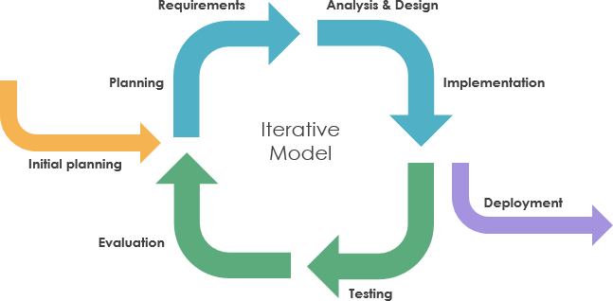
METHODOLOGY

Slide 7
SYSTEM MODULES
Login Module
Registration Module
Role Module
Common Notice Board
Class Notice Board
Teacher and Student Info
Upcoming Events
My Complaints and Feedbacks

Slide 8
FEATURES
Role based module
Push Notification
User Friendly

Slide 9
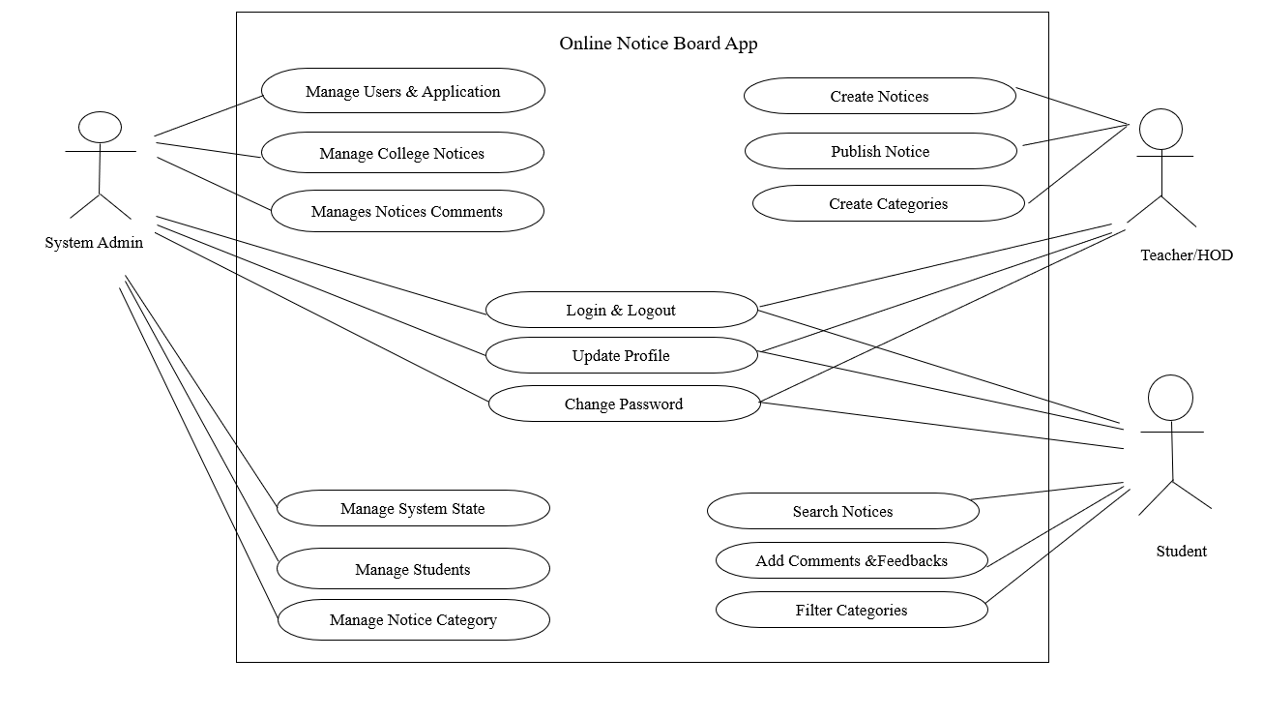
USE CASE DIAGRAM

Slide 10
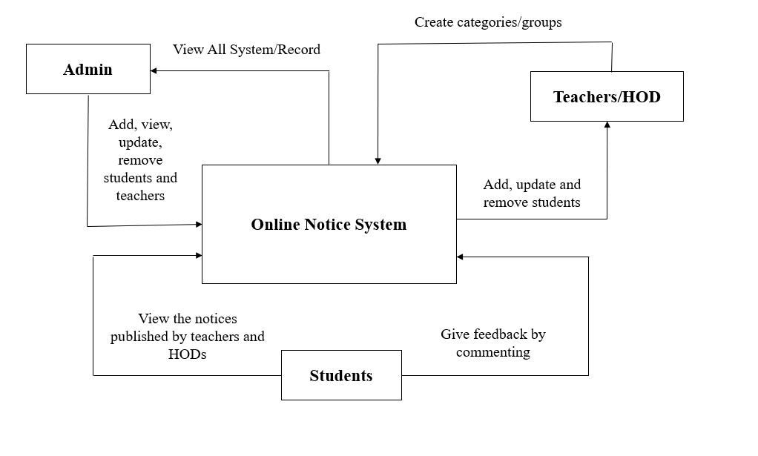
BLOCK DIAGRAM

Slide 11
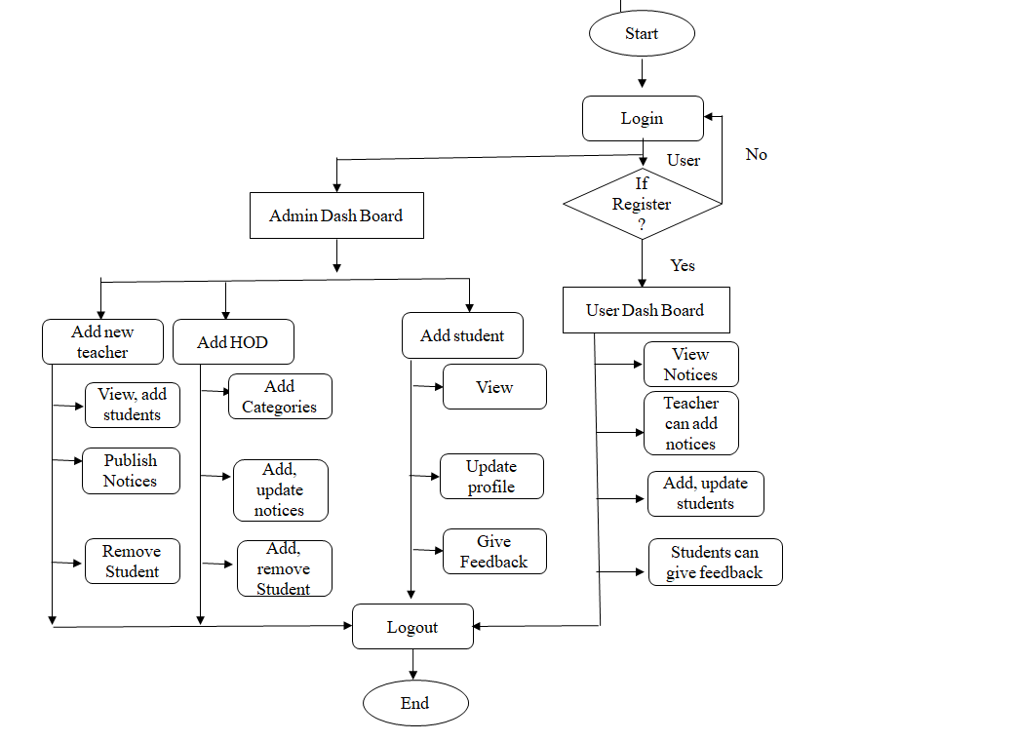
FLOWCHART

Slide 12
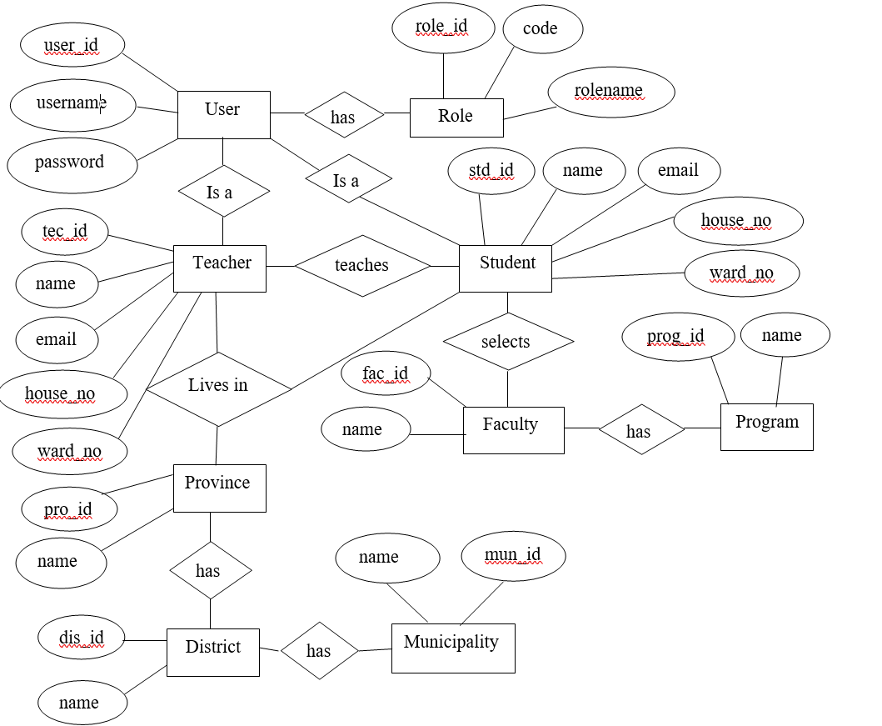
ER Diagram

Slide 13
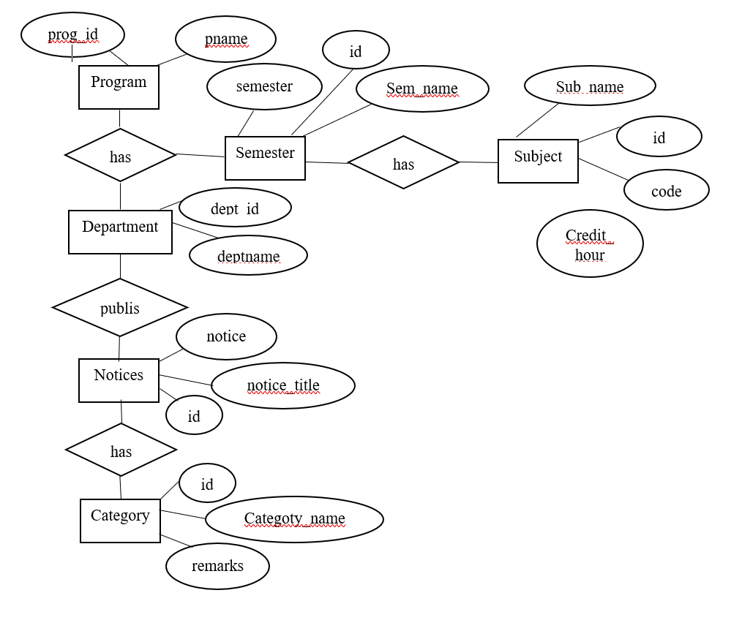
Continued..

Slide 14
SIGNIFICANCE
It will minimize the cost used to print papers and other supplies used for posting to a normal notice board.
The system will reduce the energy and time the users take to spend checking the notice board.
It will create a great interface for users to interact with posts.
It will become the best communication method to broadcast notices and information between the college administration and students.

Slide 15
SCOPE
It is applicable to colleges.
The students are kept updated each time the online notice board for college is uploaded based on their preferences with respect to the departments and categories through a notice board online.

Slide 16
LIMITATION
It is only applicable to colleges.
It requires the facility of the internet to run this app.
The user should be registered in the college database to access the information.

Slide 17
RECOMMENDATIONS
Feature to record student’s attendance can be added.
Result Displaying feature can be added.

Slide 18
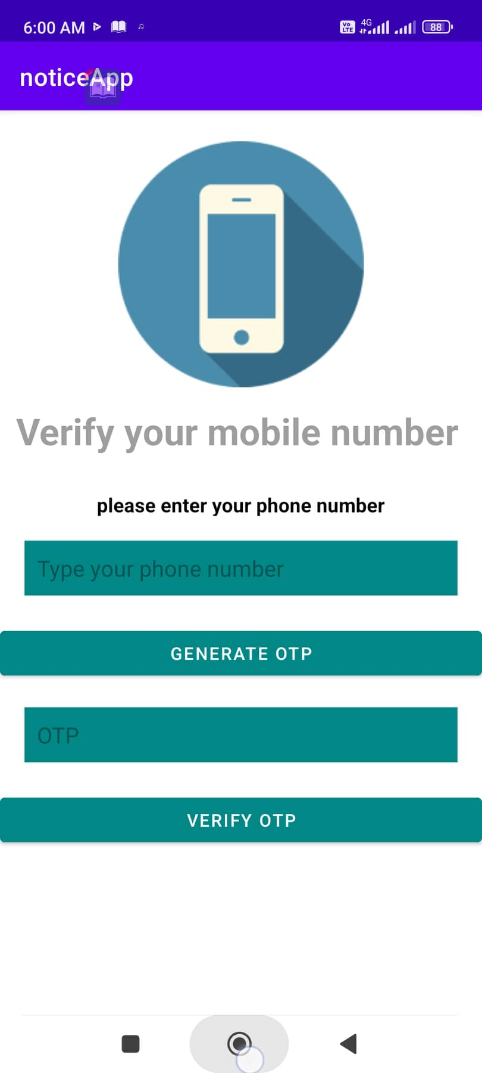
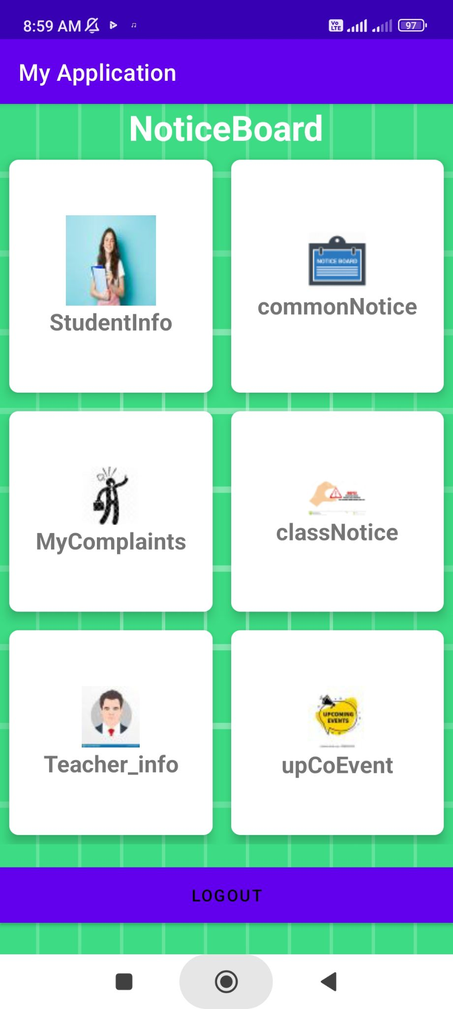
ANNEX

Slide 19
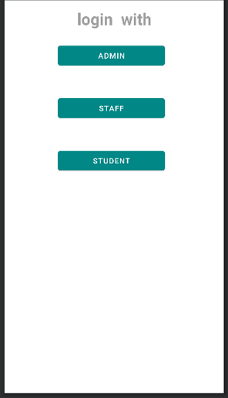
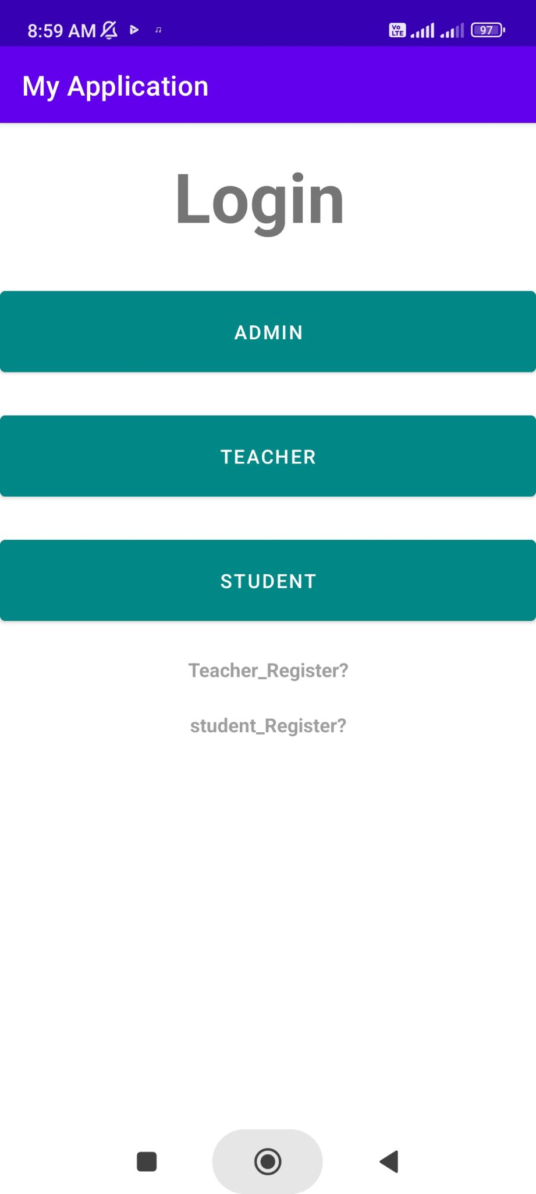

Slide 20
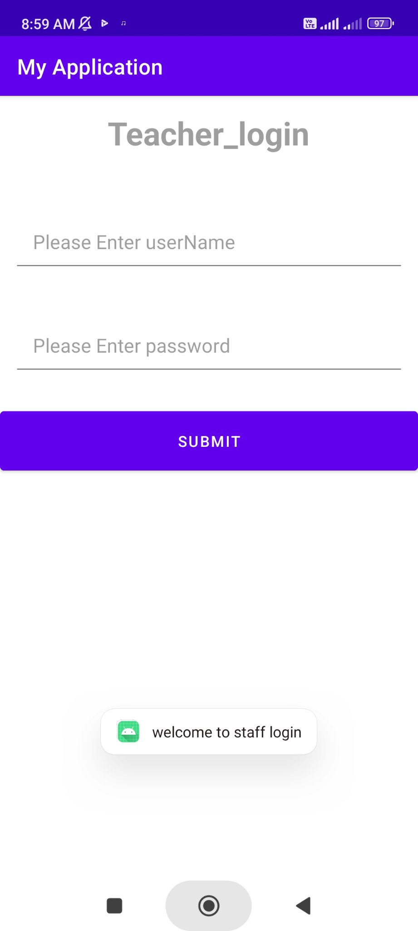
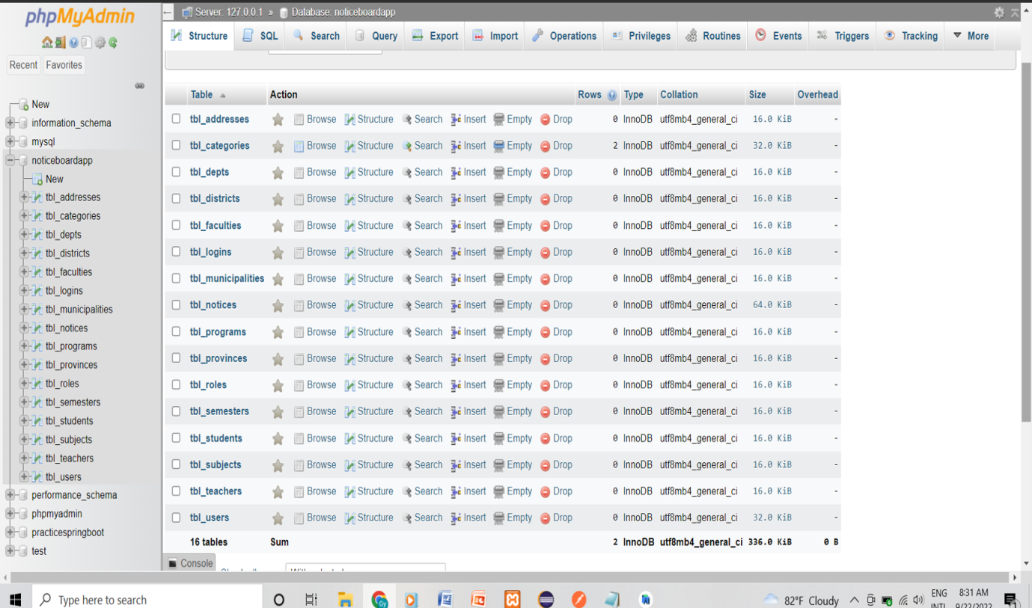

Slide 21
Thank you!!
Any Queries?

